Slide 1
Task 1 Update
Peter Sharpe
Harvard-MIT Center for Advanced Climate Research

Slide 2
Battery Modelling

Slide 3
Battery Modelling: Where We Left Off
An energy stack-up is used to size Dawn’s battery.
We noticed strange results if the same stack-up was applied to Odysseus*:
Odysseus Battery Mass
Predicted w/ Dawn method
542 kg
As-built
275 kg
Using Odysseus information given to 16.82 class (outdated)
Possibilities:
Our physics models are wrong, and Dawn’s battery is oversized.
Odysseus’s battery is undersized.
The supplied Odysseus data is wrong.
1.97x discrepancy! ☹
* Assuming Odysseus is sized to 35N, Dec. 21; 265 Wh/kg @ cell

Slide 4
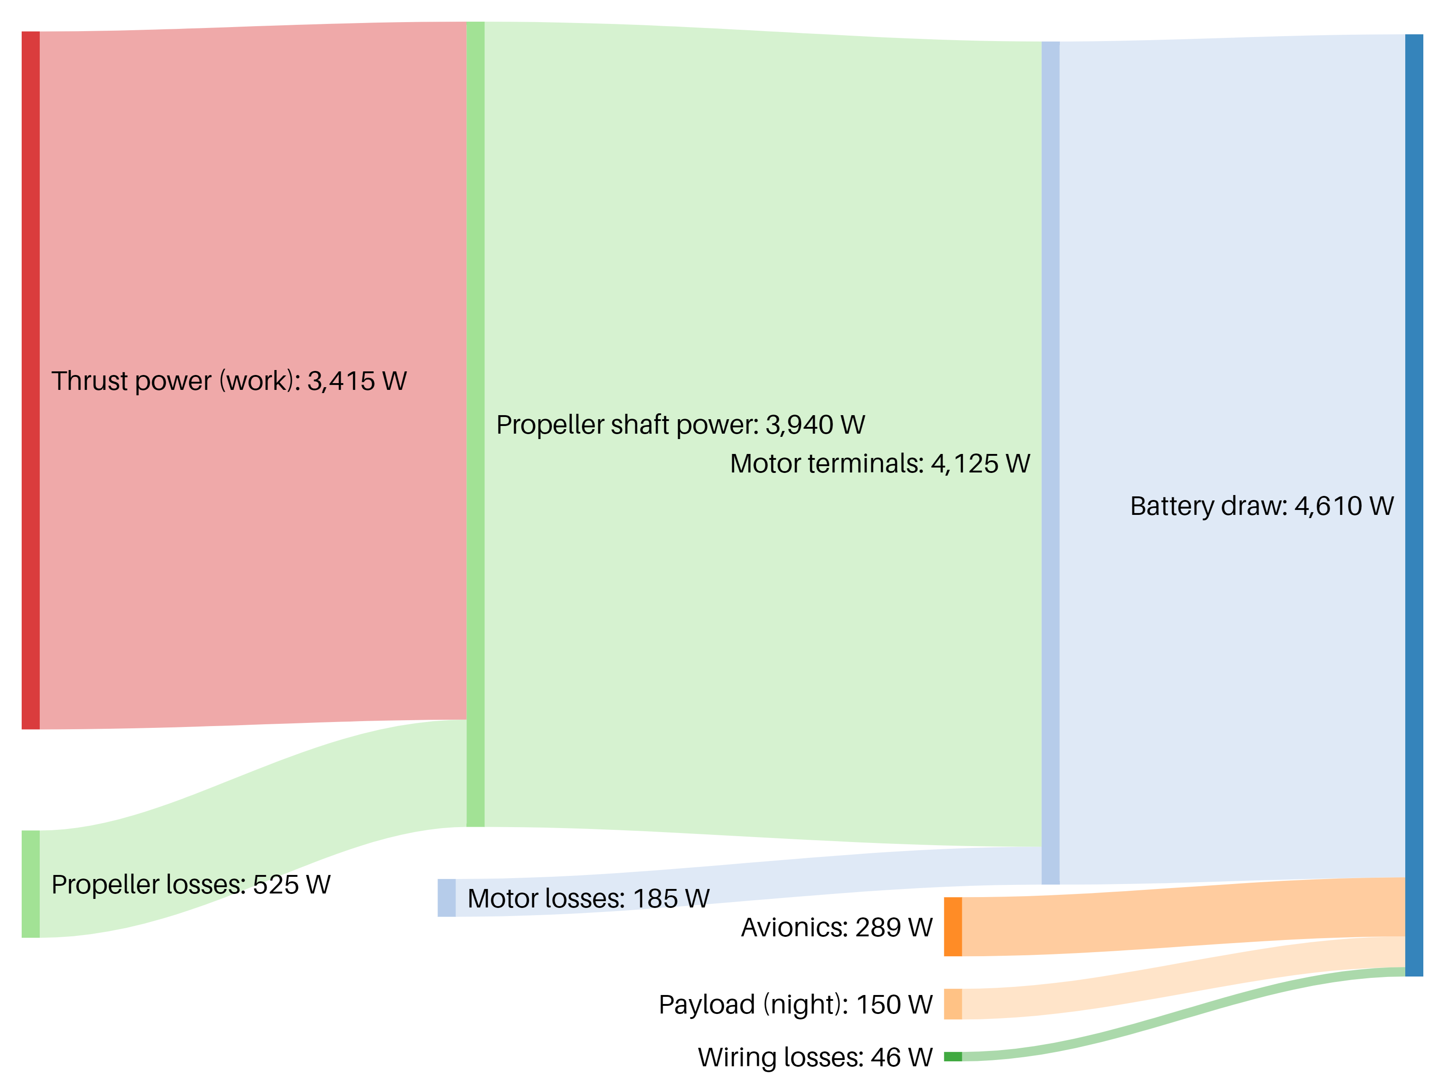


Battery Modelling: Dawn Stack-up
Power Stack
Thrust power found by momentum argument
4.6 kW
$$η=86\%$$
$$η=95\%$$
Notes:
Battery draw [4125] Motor terminals
Battery draw [289] Avionics
Battery draw [150] Payload (night)
Battery draw [46] Wiring losses
Motor terminals [3940] Propeller shaft power
Motor terminals [185] Motor losses
Propeller shaft power [3415] Thrust power (work)
Propeller shaft power [525] Propeller losses

Slide 5
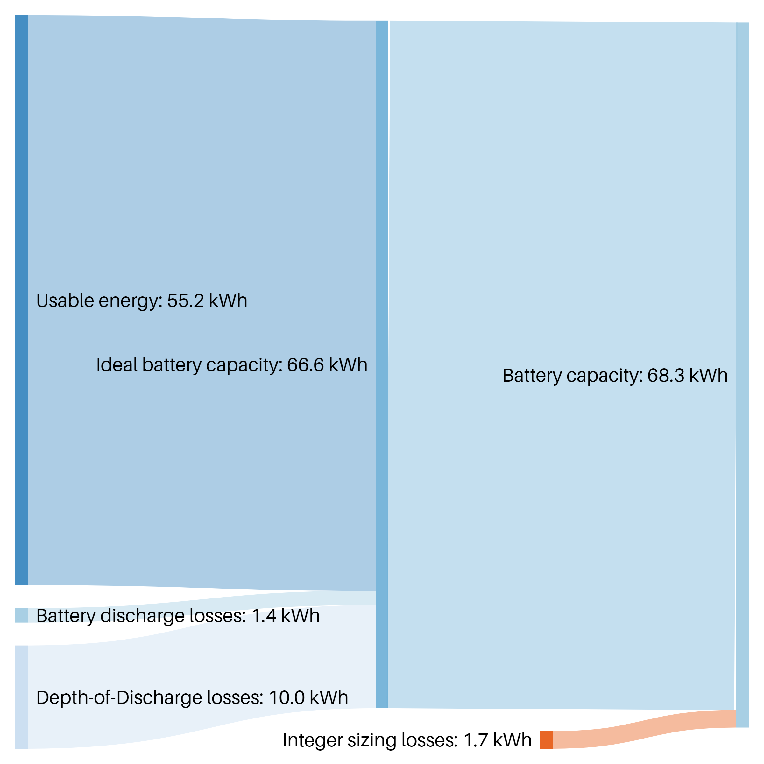




Battery Modelling: Dawn Stack-up
Energy Stack (Aug. 31, 49N)
4.6 kW
12 hr.
55.2 kWh
68.3 kWh
$$×$$
$$=$$
Night: 10.85 hr.
Night incl. twilight: 13.62 hr.
$$η=97.5\%$$
DoD $=85\%$
Notes:
' Type a list of Flows, like this:
' SOURCE [AMOUNT] TARGET
' Examples:
Usable energy [55.2] Ideal battery capacity
Battery discharge losses [1.4] Ideal battery capacity
Depth-of-Discharge losses [10] Ideal battery capacity
Ideal battery capacity [66.6] Battery capacity
Integer sizing losses [1.7] Battery capacity

Slide 6
Battery Modelling: Dawn Stack-up
Mass Stack
Cell packing factor of 75%*:
BMS
Pack installation
Thermal management
68.3 kWh
202 kg
450 Wh/kg
* Slightly more optimistic than quotes from Ed Lovelace (70%).

Slide 7
Battery Modelling: Resolved
Revised Odysseus numbers received from Kevin Uleck
Figure of Merit |  |  |  | Impact for Dawn sizing
Battery Specific Energy | 265 Wh/kg | → | 350 Wh/kg | N/A
Battery Depth of Discharge | 85% | → | 95% | Large, but is this realistic? Disagrees with electric aircraft lit. (~80-85%). Enabled by “SafeCell” tech?
Battery Packing Factor | 70% | → | 89% | Huge! Definitively true - Odysseus is an existence proof.
… |  | … |  | …
With new assumptions:
Odysseus Battery Mass
Predicted w/ Dawn method
287 kg
As-built
275 kg
Using Odysseus information given in personal correspondence (latest)
1.04x discrepancy! ☺

Slide 8
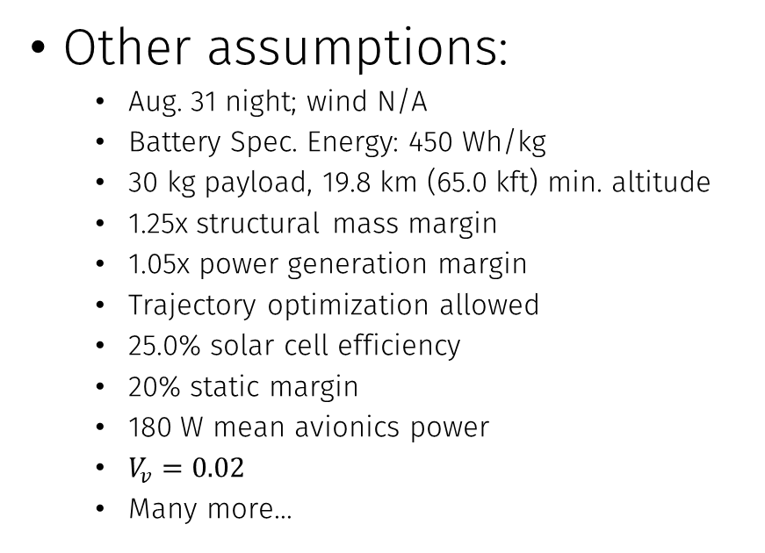
Battery Modelling: Design Implications
Temporary; need to verify that this is realistic before baselining to this. Old value: 85%
Key assumptions (relative to CDR):
Battery Depth of Discharge: 95%
Battery Packing Factor: 89%
MicroLink cells on mission airplane
To be used in all future analyses. Old value: 75%
Other assumptions:
Aug. 31 night; wind N/A
Battery Spec. Energy: 450 Wh/kg
30 kg payload, 19.8 km (65.0 kft) min. altitude
1.25x structural mass margin
1.05x power generation margin
Trajectory optimization allowed
25.0% solar cell efficiency
20% static margin
180 W mean avionics power
$V_{v}=0.02$
Many more…
suspect

Slide 9
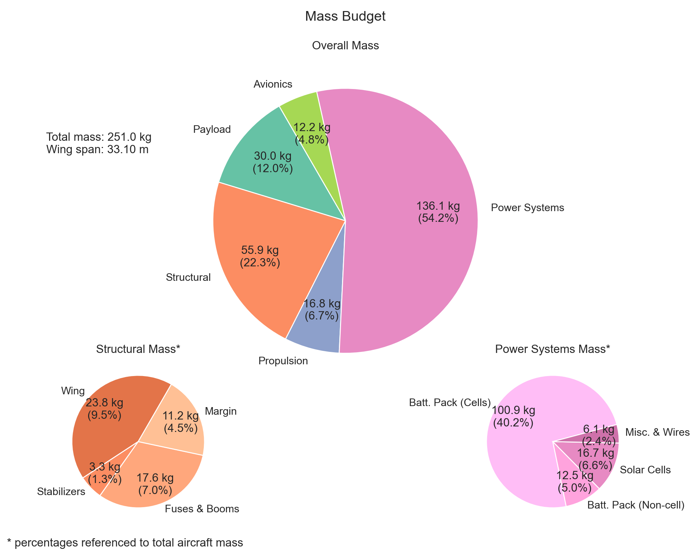
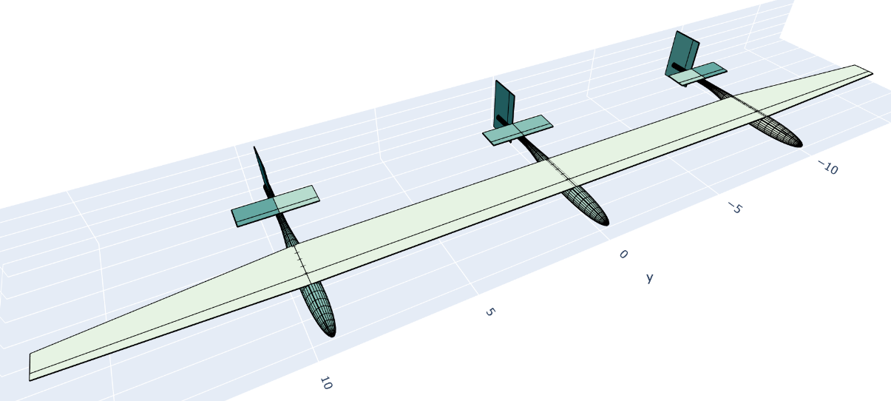
Battery Modelling: Design Implications
Resulting airplane:
33.1 m wingspan
251 kg TOGW
This is smaller than MIT Daedalus!!!

Slide 10
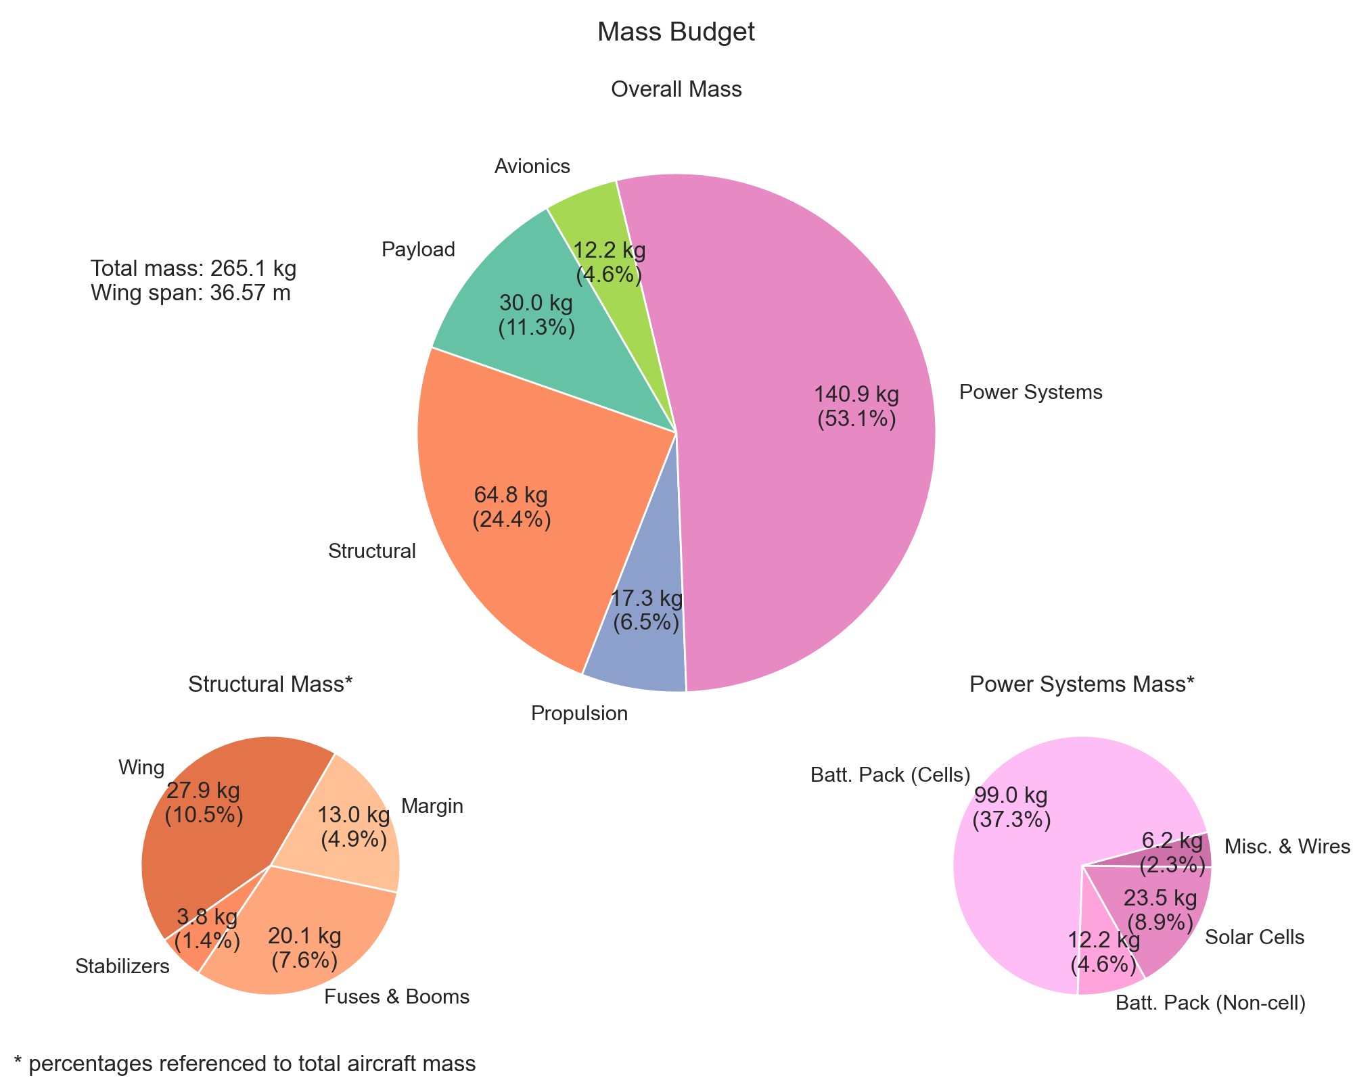
Other Option: SunPower on Mission Airplane
Resulting airplane:
36.6 m wingspan
265 kg TOGW
Much cheaper + simpler development, but results in larger final airplane

Slide 11
Trades

Slide 12
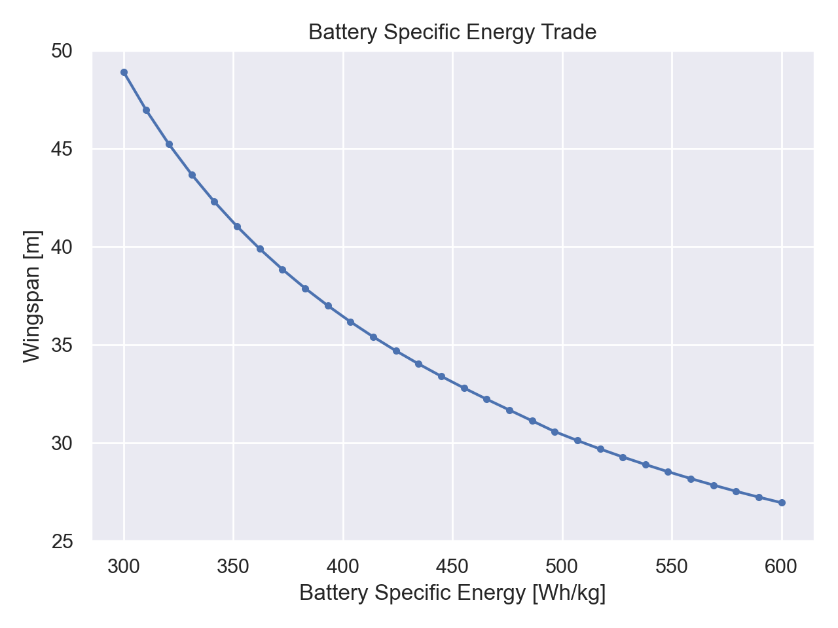
Impacts of Battery Specific Energy
Our design

Slide 13
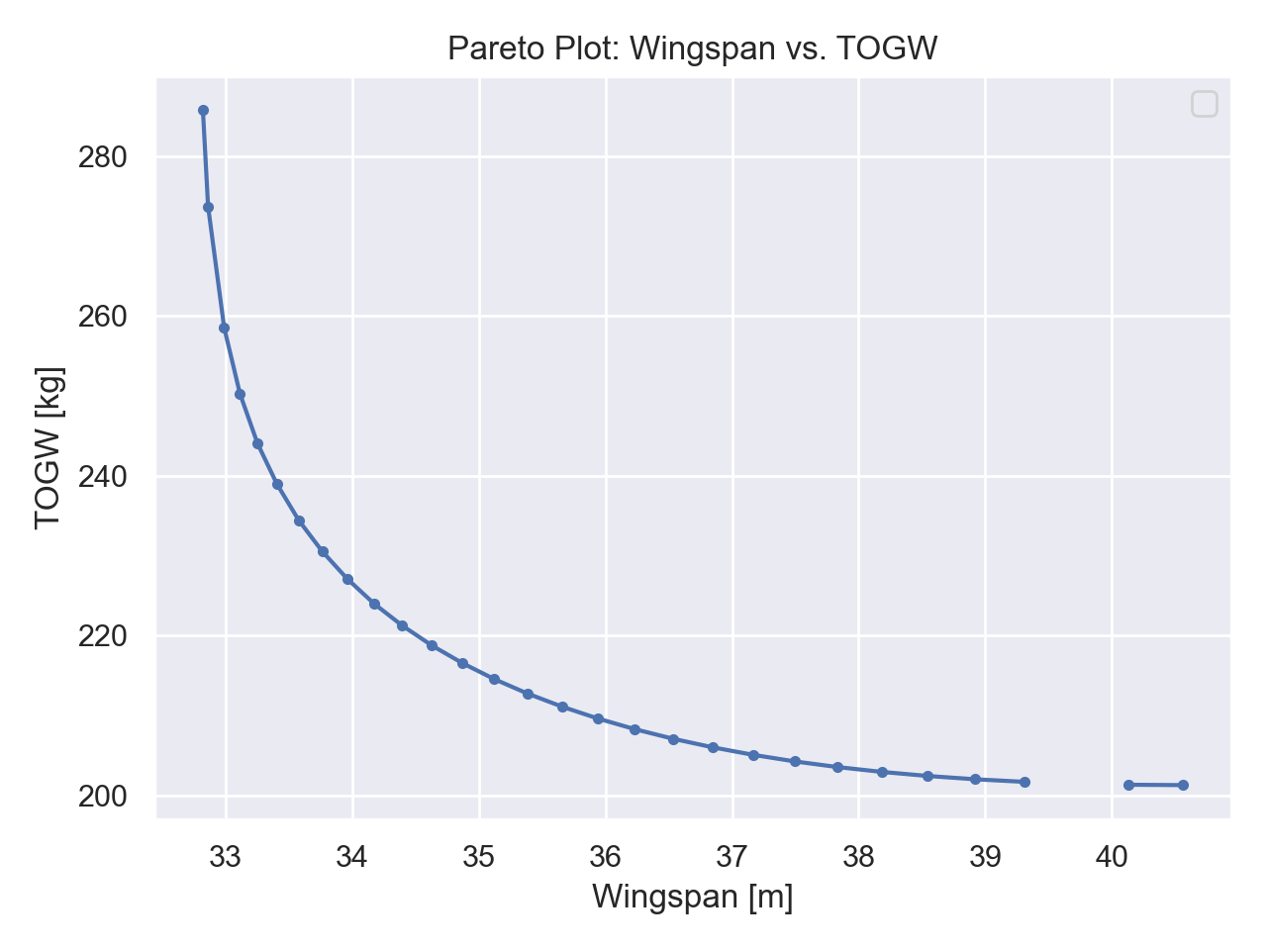
Wingspan vs. TOGW: Pareto Plot

Slide 14
Graphics for Pitches

Slide 15
Graphics: Outer Mold Line

Slide 16
Open Questions
Questions for Mark:
Current secondary wing mass assumption:
Daedalus-like component build up with 1.3x multiplier to reflect fragility of Daedalus
Is 1.3x enough?
Questions for Task 2 team:
Estimates for solar panel “glue weight” (if applicable and significant)?
Actual glue
Wiring between panels
Restrictions on airfoil design (e.g. curvature) from solar panels?
Question for Tina:
Do we have a Dropbox?

